Slide 1
Text classification
BY: Khaled Mohammed
Teaching Assistant at Faculty of Engineering
Khaled.edu.engineer@gmail.com

Slide 2



Naive Bayes
Naïve Bayes is a probability-based classifier.
  Its goal is to find the class C (for example: positive vs negative sentiment) that is most likely given the words in a document:
Using Bayes’ theorem:
Since the denominator is the same for all classes, we compare only:

Slide 3

The Naïve Assumption
We assume every word is independent of the others given the class, So:
This assumption is not true in real language, but it works extremely well because:
  It simplifies the math
  Works well in high-dimensional sparse text
  Word frequencies capture a lot of signal (ex: “good”, “love”, “great” → positive)

Slide 4
How Naïve Bayes Works for Text
Given a document with words:
  I love this movie
We want to compute:
And the same for negative.
The class with the higher probability is selected.

Slide 5

Which Naïve Bayes is used for text?
We use Multinomial Naïve Bayes because it counts words:
Why Laplace smoothing (+1)?
  To avoid zeros
  If a word never appears in a class → its probability becomes 0 → whole product becomes 0
  Laplace smoothing solves it

Slide 6
Detailed Example
We have 4 training documents, each belonging to class c or j:
Test document (Doc 5):
  Chinese Chinese Chinese Tokyo Japan
We want to decide: Is it class c or class j?
Doc | Words | Class
1 | Chinese Beijing Chinese | c
2 | Chinese Chinese Shanghai | c
3 | Chinese Macao | c
4 | Tokyo Japan Chinese | j

Slide 7

Step 1: Priors
Because:
  3 documents are class c
  1 document is class j

Slide 8
Step 2: Count words with Laplace Smoothing
Vocabulary:
  Chinese, Beijing, Shanghai, Macao, Tokyo, Japan
  |V| = 6
Count total words per class:
  For class c
    Docs 1, 2, 3:
    Doc1: Chinese Beijing Chinese → 3 words
    Doc2: Chinese Chinese Shanghai → 3 words
    Doc3: Chinese Macao → 2 words
    Total words = 8
  For class j
    Doc 4:
    Tokyo Japan Chinese → 3 words
    Total words = 3

Slide 9
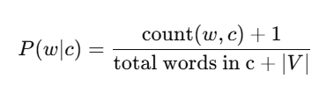
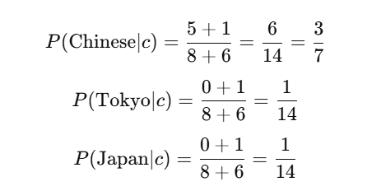
Step 3: Compute Conditional Probabilities
For class c:
  count(Chinese, c) = 5
  count(Tokyo, c) = 0
  count(Japan, c) = 0
So:

Slide 10
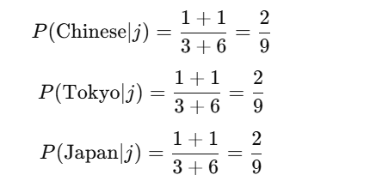
Cont.
For class j:
Counts from Doc 4:
  Tokyo: 1
  Japan: 1
  Chinese: 1
Total = 3

Slide 11


Step 4: Compute probability of class for Doc 5
Document 5:
  Chinese Chinese Chinese Tokyo Japan
Number of each word:
  Chinese ×3
  Tokyo ×1
  Japan ×1
For class c
Substitute:
Numerically ≈ 0.0003

Slide 12
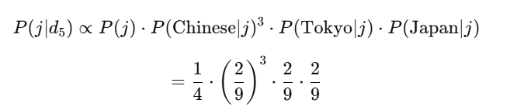
CONT.
For class j
Numerically ≈ 0.0001

Slide 13

Final Decision
So the document is classified as class c.

